Slide 2


Root and Subordinate CA Certificates
Root CA
(Offline)
Self-signed
Intermediate CA
Chain of trust
Notes:
Client presents the list of supported cipher suite

Slide 3


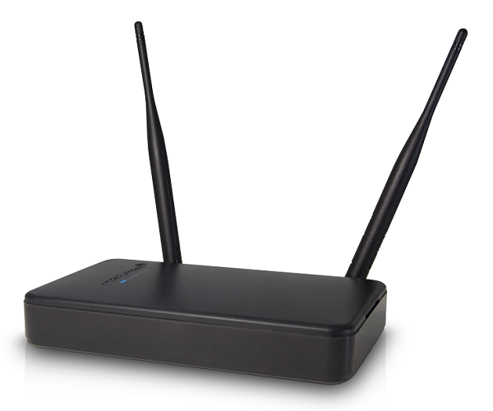
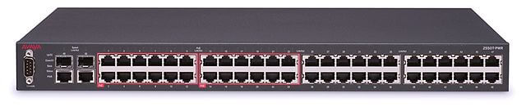
Machine Certificates
Servers
Web servers
Remote access
Proxy servers
Client Machines
Network Devices
Notes:
Client presents the list of supported cipher suite

Slide 4




User Certificates
Email
Disk encryption
Identity
Notes:
Identity to remote users/computers

Slide 5




Email Certificates – S/MIME
Public key
Private key decrypts email
Public and Private Keys
Encrypts email
Notes:
Client presents the list of supported cipher suite

Slide 6
Code Signing Certificate
Prove identity of vendor
Ensures integrity of software
Operating systems use to validate
Notes:
Managed Devices
Routers
Access Servers
Switches
Printers
IP camer
Agent (runs on managed devices)
Management stations (monitor and control managed devices)

Slide 7
Wildcard Certificate
Use to identify a parent domain
Verifies all sub(child) domains
Represented by an asterisk “*”
Example
*.itpro.tv
*google.com
Notes:
Managed Devices
Routers
Access Servers
Switches
Printers
IP camer
Agent (runs on managed devices)
Management stations (monitor and control managed devices)

Slide 8
Validation Certificates
Domain Validation (DV)
Lowest level of validation
Verifies ownership over domain
Organization Validation (OV)
Greater validation than DV
Verifies the identity of organization
Extended Validation (EV)
Highest form of organization identification
Most rigorous validation process
Individual Validation (IV)
Verifies identity of individual
Notes:
Managed Devices
Routers
Access Servers
Switches
Printers
IP camer
Agent (runs on managed devices)
Management stations (monitor and control managed devices)

Slide 9
Certificates Formats
Certificate Formats | Purpose
Distinguished Encoding Rules (.der) | Binary encoded Does not include private key (.cer)
Privacy Enhanced Mail (PEM) | Base64 ASCII encoded Various extensions (.pem, .cer, .crt)
Public Key Cryptography Standards #7 (PKCS#7) | Includes public key, certificate information, certificate chain (.P7B)
Public Key Cryptography Standards #12 (PKCS#12) | Includes both public/private keys, certificate information (includes extended properties) and certificate chain

